Slide 1

P4PI L2 enhanced switch
Team members: Hussein Abu Jabal, Haneen Jeries
Instructor: Eran Tavor

Slide 2


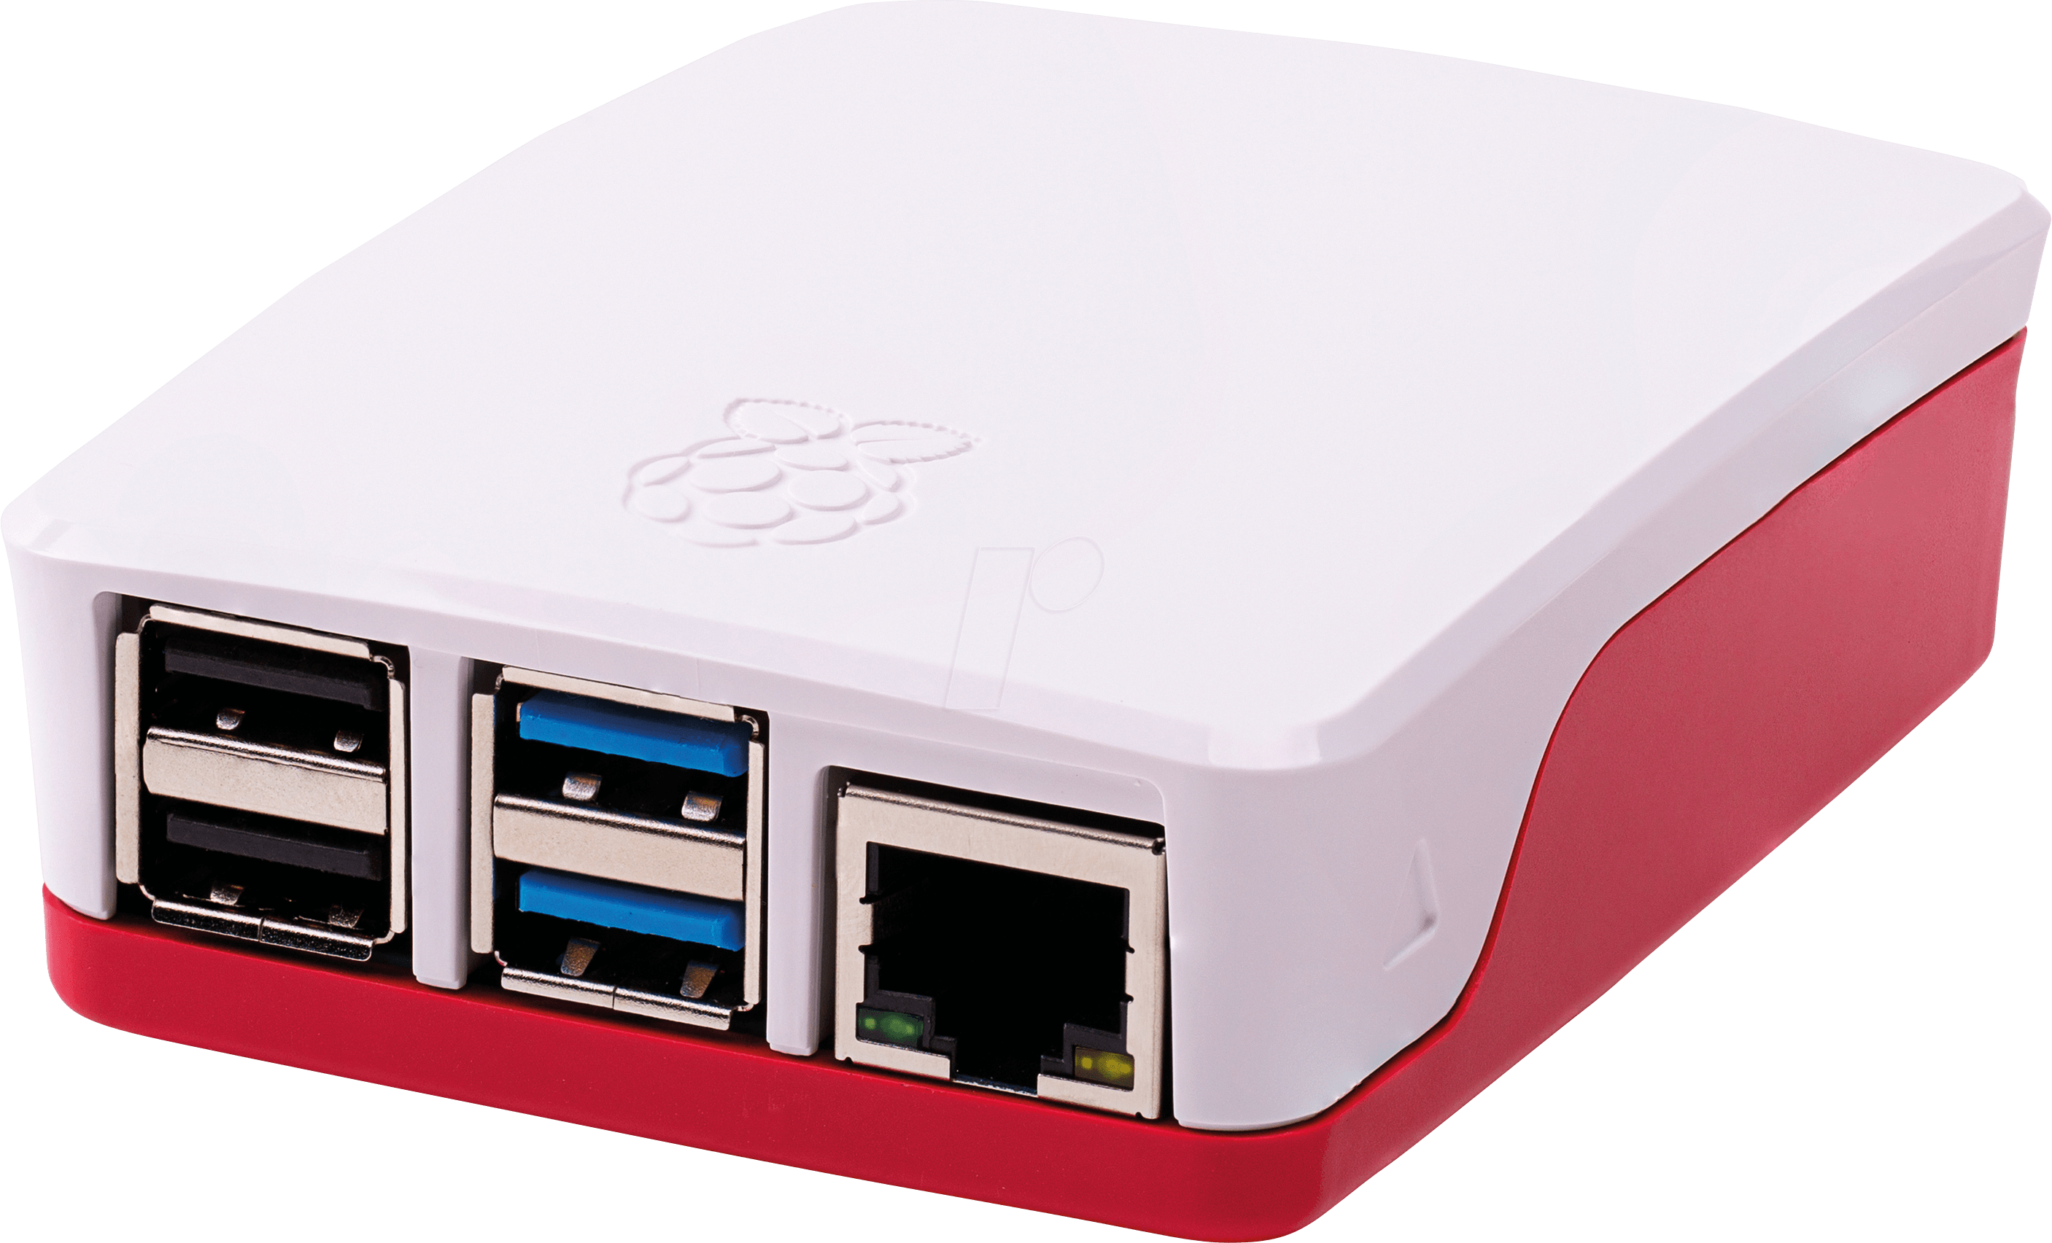
P4PI L2 enhanced switch
In this project, we aspire to develop a private encrypted network (Tunneling) using 2 P4PI devices.
Internet
PPP tunnel
User A
User B
2

Slide 3
Background

Slide 4




Basic Concepts:
PPP
P4PI
P4
Tunneling Protocol
VPN
PPP

Slide 5
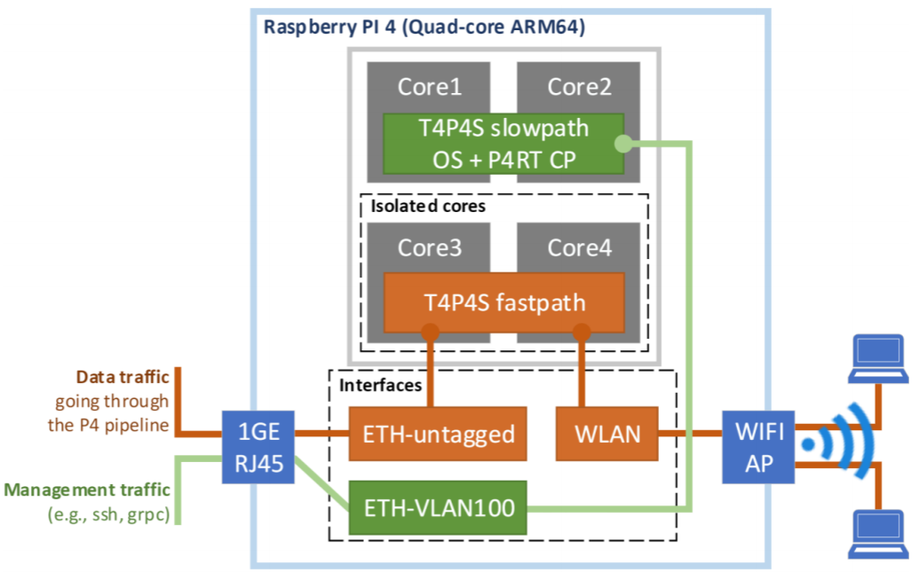

P4PI
P4PI is a small scale functional programmable switch/Router based on open-source code.

Slide 6
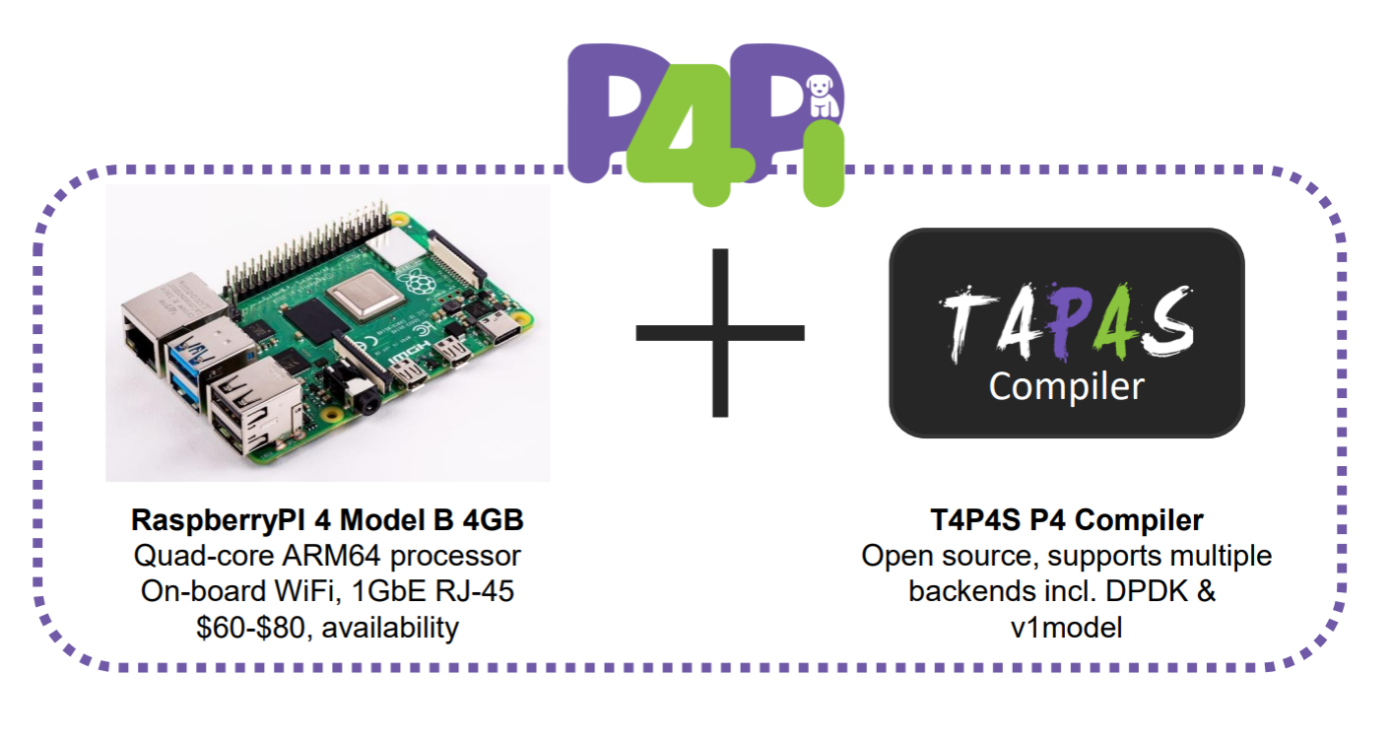
P4PI
The platform is based on the Raspberry Pi board and uses the P4 programming language and the open-source T4P4S P4 Compiler and open-source hardware.

Slide 7
P4
P4 is a programming language for controlling packet forwarding planes in networking devices, such as routers and switches.

Slide 8
Tunneling protocol
Tunneling Protocol is a communications protocol that allows for the transferring of data from one network to another.
It involves allowing private network communications to be sent across the Internet securely through a process called encapsulation.
in this project, we will use PPP (Point-to-Point Protocol) over UDP as a tunneling protocol.

Slide 9
VPN – Virtual Private Network
A standard VPN works by establishing a secure tunnel between a client and a private network.
Whereas in our project the VPN is created by establishing a secure tunnel between a local network and a private network, without clients intervening.
The 2 P4PI devices serve as the two end points of the tunnel.

Slide 10
PPP – Point To Point Protocol
PPP is a data link protocol, resides at layer 2 of OSI model.
PPP is used to encapsulate layer 3 protocols for transmission across a network only between 2 devices connected on a link

Slide 11
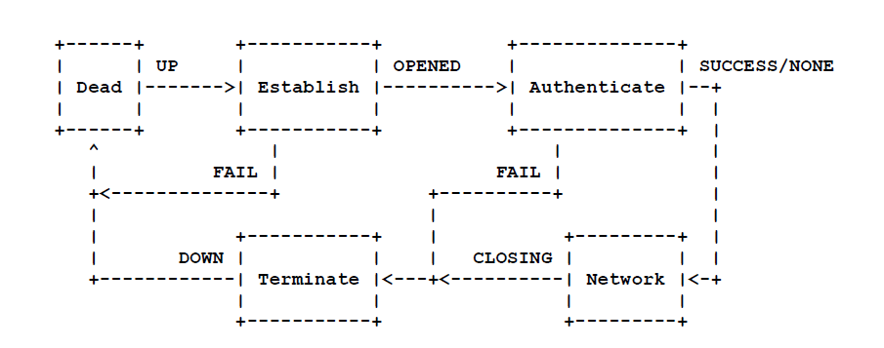
PPP Phase Diagram
PPP connection generally goes through different phases that can be seen in Transition Phase Diagram as shown below

Slide 12
The journey of a packet

Slide 13

The journey of a packet
User A is connected to the first switch, and wants to send a packet to user B.
User B is sitting in a private network which is connected to the second switch.
Internet
PPP tunnel
User A
User B
Notes:
If the PPP connection is already established skip step 2.
User A sends a packet to user B.
Switch S1 decodes the IP header of the packet, and notices that the packet is meant for User B. S1 establishes a PPP connection with switch S2, according to the process described in the PPP section.
S1 encapsulates the packet using PPP, and then encrypts the PPP packet using AES algorithm, and sends the packet to S2 using UDP protocol on port 1701.
Switch S2 receives the packet, decrypt it from using AES, and then decapsulates the PPP packet, and sends the packet (PPP payload) to User B according to his IP address which is found in the IP header of the original packet.
User B receives the packet.

Slide 14
Implementation

Slide 15
PPP Packet Header layout:
Flag
Protocol
Payload
FCS
Flag
Ethernet
IP
UDP/TCP
Payload
Notes:
Flag: marks the beginning or the ending of the packet
Protocol: determines the type of data to be sent in payload (LCP/NCP)
Payload: actual data
FCS: used for error detection: CRC

Slide 16
Packet Header layout:
Flag
Protocol
Payload
FCS
Flag
UDP
Flag
Protocol
Payload
FCS
Flag
IP
UDP
Flag
Protocol
Payload
FCS
Flag
Ethernet
IP
UDP
Flag
Protocol
Payload
FCS
Flag

Slide 17
Packet manipulation in P4
When a packet is received in a P4Pi switch, it goes through several phases until it is retransmitted or dropped.
Parsing.
Verifying Checksum.
Ingress.
Egress.
Compute Checksum.
De-parsing.
Notes:
מניפולציות על חבילות ב-P4:
כאשר חבילה מגיעה ל-switch, היא עוברת במספר שלבים:
Parsing - ניתוח החבילה וחילוץ הכותרות בפורמט הנכון.
Verifying Checksum - בודק שכותרות החבילות תקפות.
Ingress - ציון כללי החבילות הנכנסות ואופן הטיפול בהן.
Egress - ציון כללי החבילות היוצאות ודרך ההתמודדות איתם. (מקור החבילה הוא P4Pi עצמו)
Compute checksum - חישוב ה-checksum של החבילה לאחר שינוי הכותרות שלה
De-parsing - בנייה מחדש של החבילה, הכנת החבילה לשידור על ידי עטיפת החבילה בכותרות חדשות.

Slide 18
Parsing phase
Packet arrives
Extract Ethernet Header
Extract IP Header
Src IP address is OtherSwitchIP
Check Tunnel
Is IP packet
Is UDP packet
Accept
Extract UDP Header
UDP destination port is 1701
Extract PPP Header
Reject

Slide 19
Parsing phase – so far
Packet arrives
Extract Ethernet Header
Extract IP Header
Src IP address is OtherSwitchIP
Check Tunnel
Is IP packet
Is UDP packet
Accept
UDP destination port is 1701
Extract UDP Header
Reject

Slide 20
Ingress Phase
After the packet is accepted in the parsing phase, it enters the ingress phase.
Given a parsed packet, we need to decide what to do with it based on its source IP address and its destination IP address. Main cases:
The destination IP is in the other switch subnet.
The source IP is the other switch IP.
Otherwise
Ethernet
IP
UDP
Flag
Protocol
Payload
FCS
Flag

Slide 21
De-Parsing Phase
Once the packet and all the required headers are ready, all is left to do is to retransmit the packet with the right headers.
We decide which headers to transmit based on the (new) source IP address and its destination IP address. Main cases:
The destination IP is in the other switch subnet. Ethernet ➔ IPV4 ➔ UDP ➔ PPP
The source IP is the other switch IP.
Otherwise Ethernet ➔ IPV4
Ethernet
IP
UDP
Flag
Protocol
Payload
FCS
Flag

Slide 22
Challenges

Slide 23

Challenge1
Every PPP packet including data and control messages, must be sent throughout the internet.
The routers throughout the routing path do not recognize the PPP protocol, and since it is implemented in Layer 2, the routers don’t know how to decode the headers of the packet and to get the packet destination.
First attempt:
Using L2tp protocol – L2 tunneling protocol is used to carry almost any Layer 2 data across the network, using UDP.
L2tp encapsulates the PPP packet and forward it from the LAC (The switch in the remote network) to the LNS (The switch in the private network).

Slide 24
PPP over L2tp
User A
PPP tunnel
Internet
L2tp tunnel
User B

Slide 25
Challenge2:
Using L2tp in order to solve the first challenge, requires the packets to be sent from the client to the router as PPP packets!
This solution involves the client, whereas the client should not be aware of the PPP tunnel.
Solution:
Wrapping the PPP packet using UDP and sending it on the internet on port 1701.

Slide 26
Challenge3:
P4 language does not allow payload manipulation.
Therefore, cannot encrypt the payload.
Solution:
Work-around: add the payload as a header.
Down-side: payload size is fixed.

Slide 27
What we have learned
Expanded our knowledge in computer networks.
Learned networking protocols such as:
PPP Studied the RFC1661
L2tp
Learned a new programming language (P4) which is used for programming routers/switches.
Learned how to work with Raspberry pi’s environment, using an OS designed for P4PI.

Slide 28

Thank You
Questions?

